Slide 1

Briefing on U.S. EPA Activities:
Great Lakes and Lake Erie
Lake Erie Millennium Network
New Investigator’s Meeting
April 2013
Russell G. Kreis, Jr.¹, Paul J. Horvatin² ,
Jack Kelly¹, Daniel O’Riordan², and Glenn J. Warren²
¹USEPA, Office of Research and Development, NHEERL; MED- Duluth, MN; Grosse Ile, MI
²USEPA, Great Lakes National Program Office,
Chicago, IL

Slide 2
APPENDIX TO THE PROTOCOL AMENDING THE AGREEMENT BETWEEN
CANADA AND THE UNITED STATES OF AMERICA
ON GREAT LAKES WATER QUALITY, 1978,
AS AMENDED ON OCTOBER 16, 1983
AND ON NOVEMBER 18, 1987
AGREEMENT BETWEEN CANADA AND
THE UNITED STATES OF AMERICA
ON GREAT LAKES WATER QUALITY, 2012
Reaffirmation
New Annexes
Action- Oriented
Effective
Modernized
Forward-Thinking

Slide 3


Contacts:
Daniel O’Riordan
USEPA, GLNPO
Luca Cargnelli
Environment Canada

Slide 4
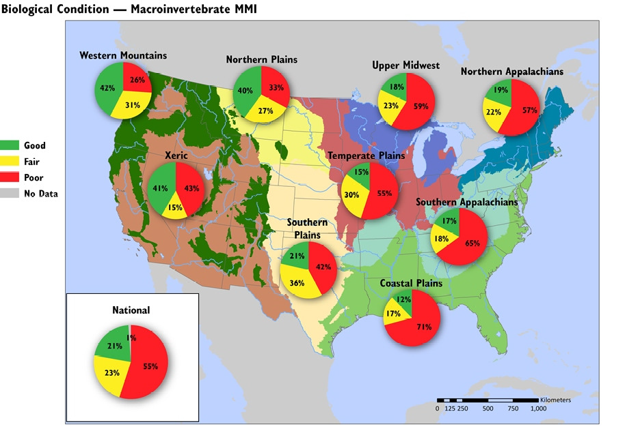
National Rivers and Streams Assessment USEPA 2013

Slide 5
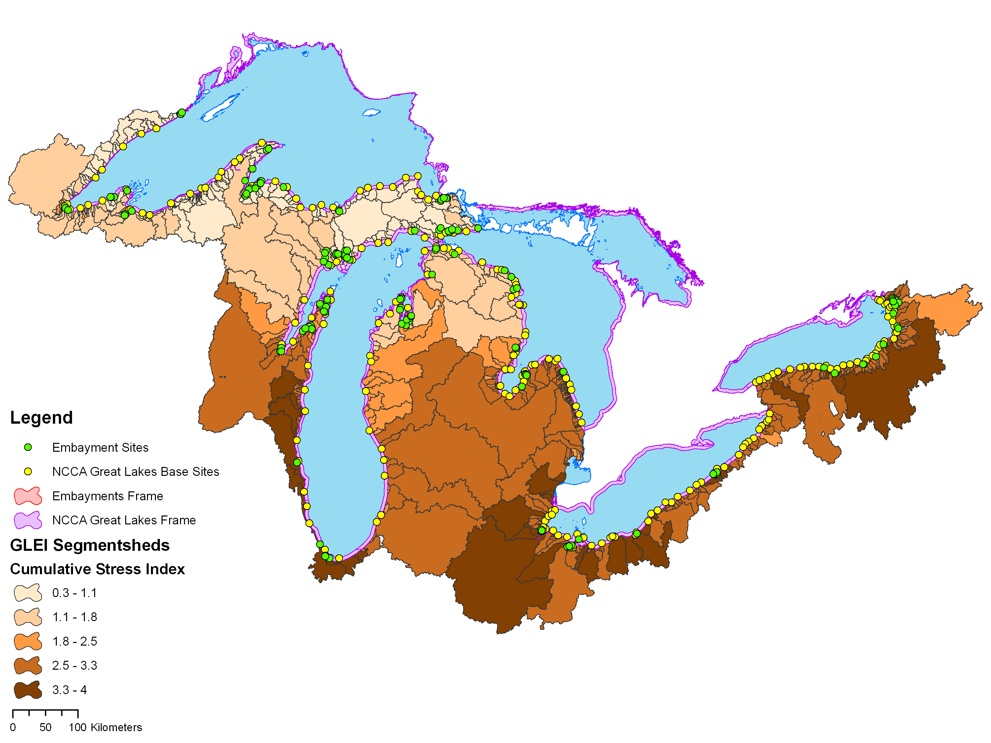
National Coastal Condition Assessment
Water Quality Index:
Water Clarity, DO, Chlorophyll a, DIN, DIP
Benthic Index:
Community Diversity, Pollution Tolerant/Sensitive Species
Sediment Quality Index:
Toxicity, Contaminants, TOC
Fish Tissue Contaminant Index:
Whole-Fish Contaminant Burden
Coastal Habitat Index:
FWS National Wetlands Inventory
Wetlands Loss Rates
Expected:
Spring 2013
NCCA 2010

Slide 6
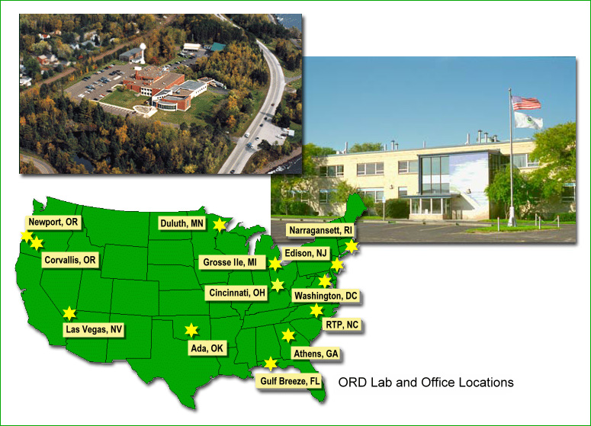
U.S. Environmental Protection Agency
Office of Research and Development
National Health and Environmental Effects Research Laboratory

Slide 7
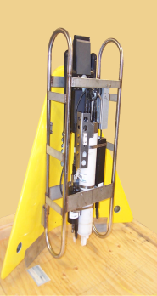
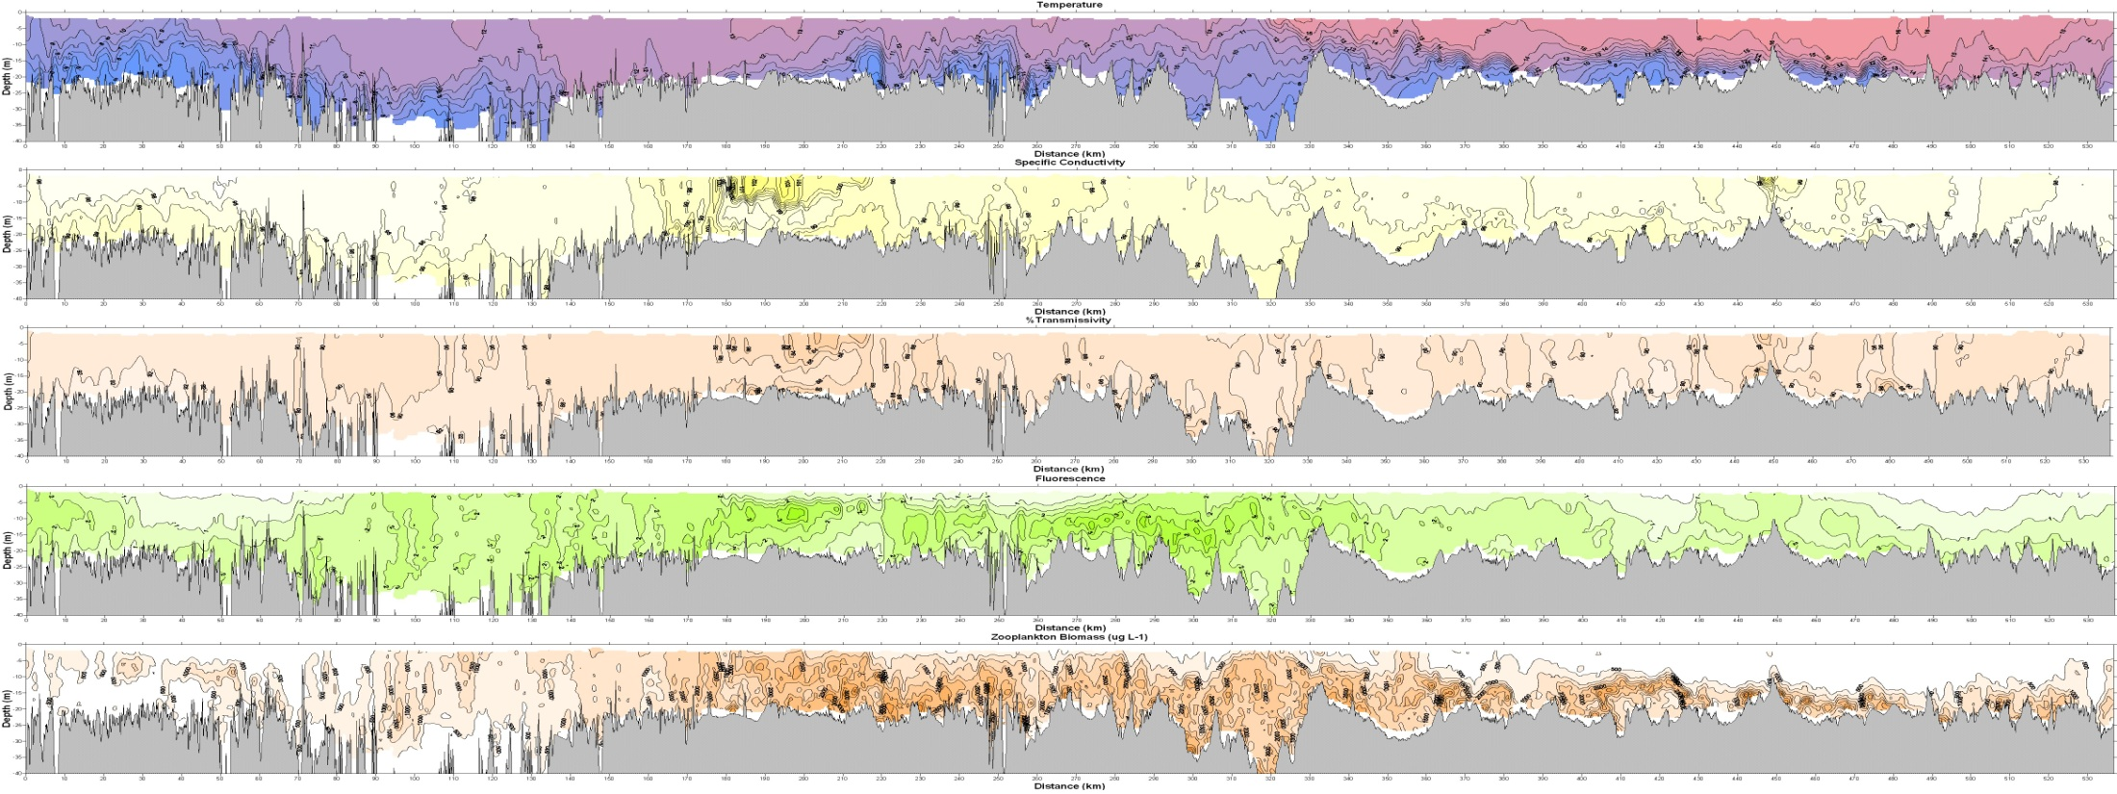
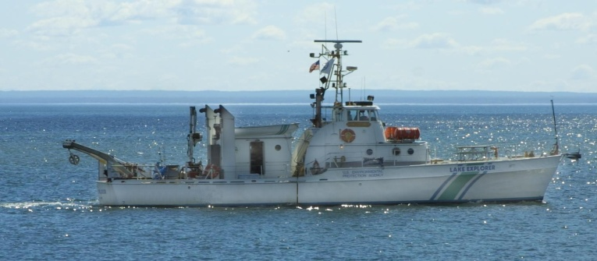
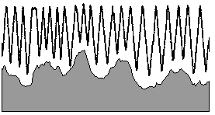
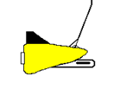
High-resolution data along 500 to 1000 km of shoreline
Sensors
CTD
Fluorometer
(calibrated to Chl a)
Transmissometer
Laser Optical Plankton Counter
(Zooplankton >150 µm)
NO₃
Alongshoreline towing survey strategy
Evolved to be along constant depth contour
Notes:
Three structural elements in development of an “Observation System”; electronic instrumentation for high resolution (backed up by point samples), towing strategy for optimal data utility, GIS for linkage to landscape stress.

Slide 8
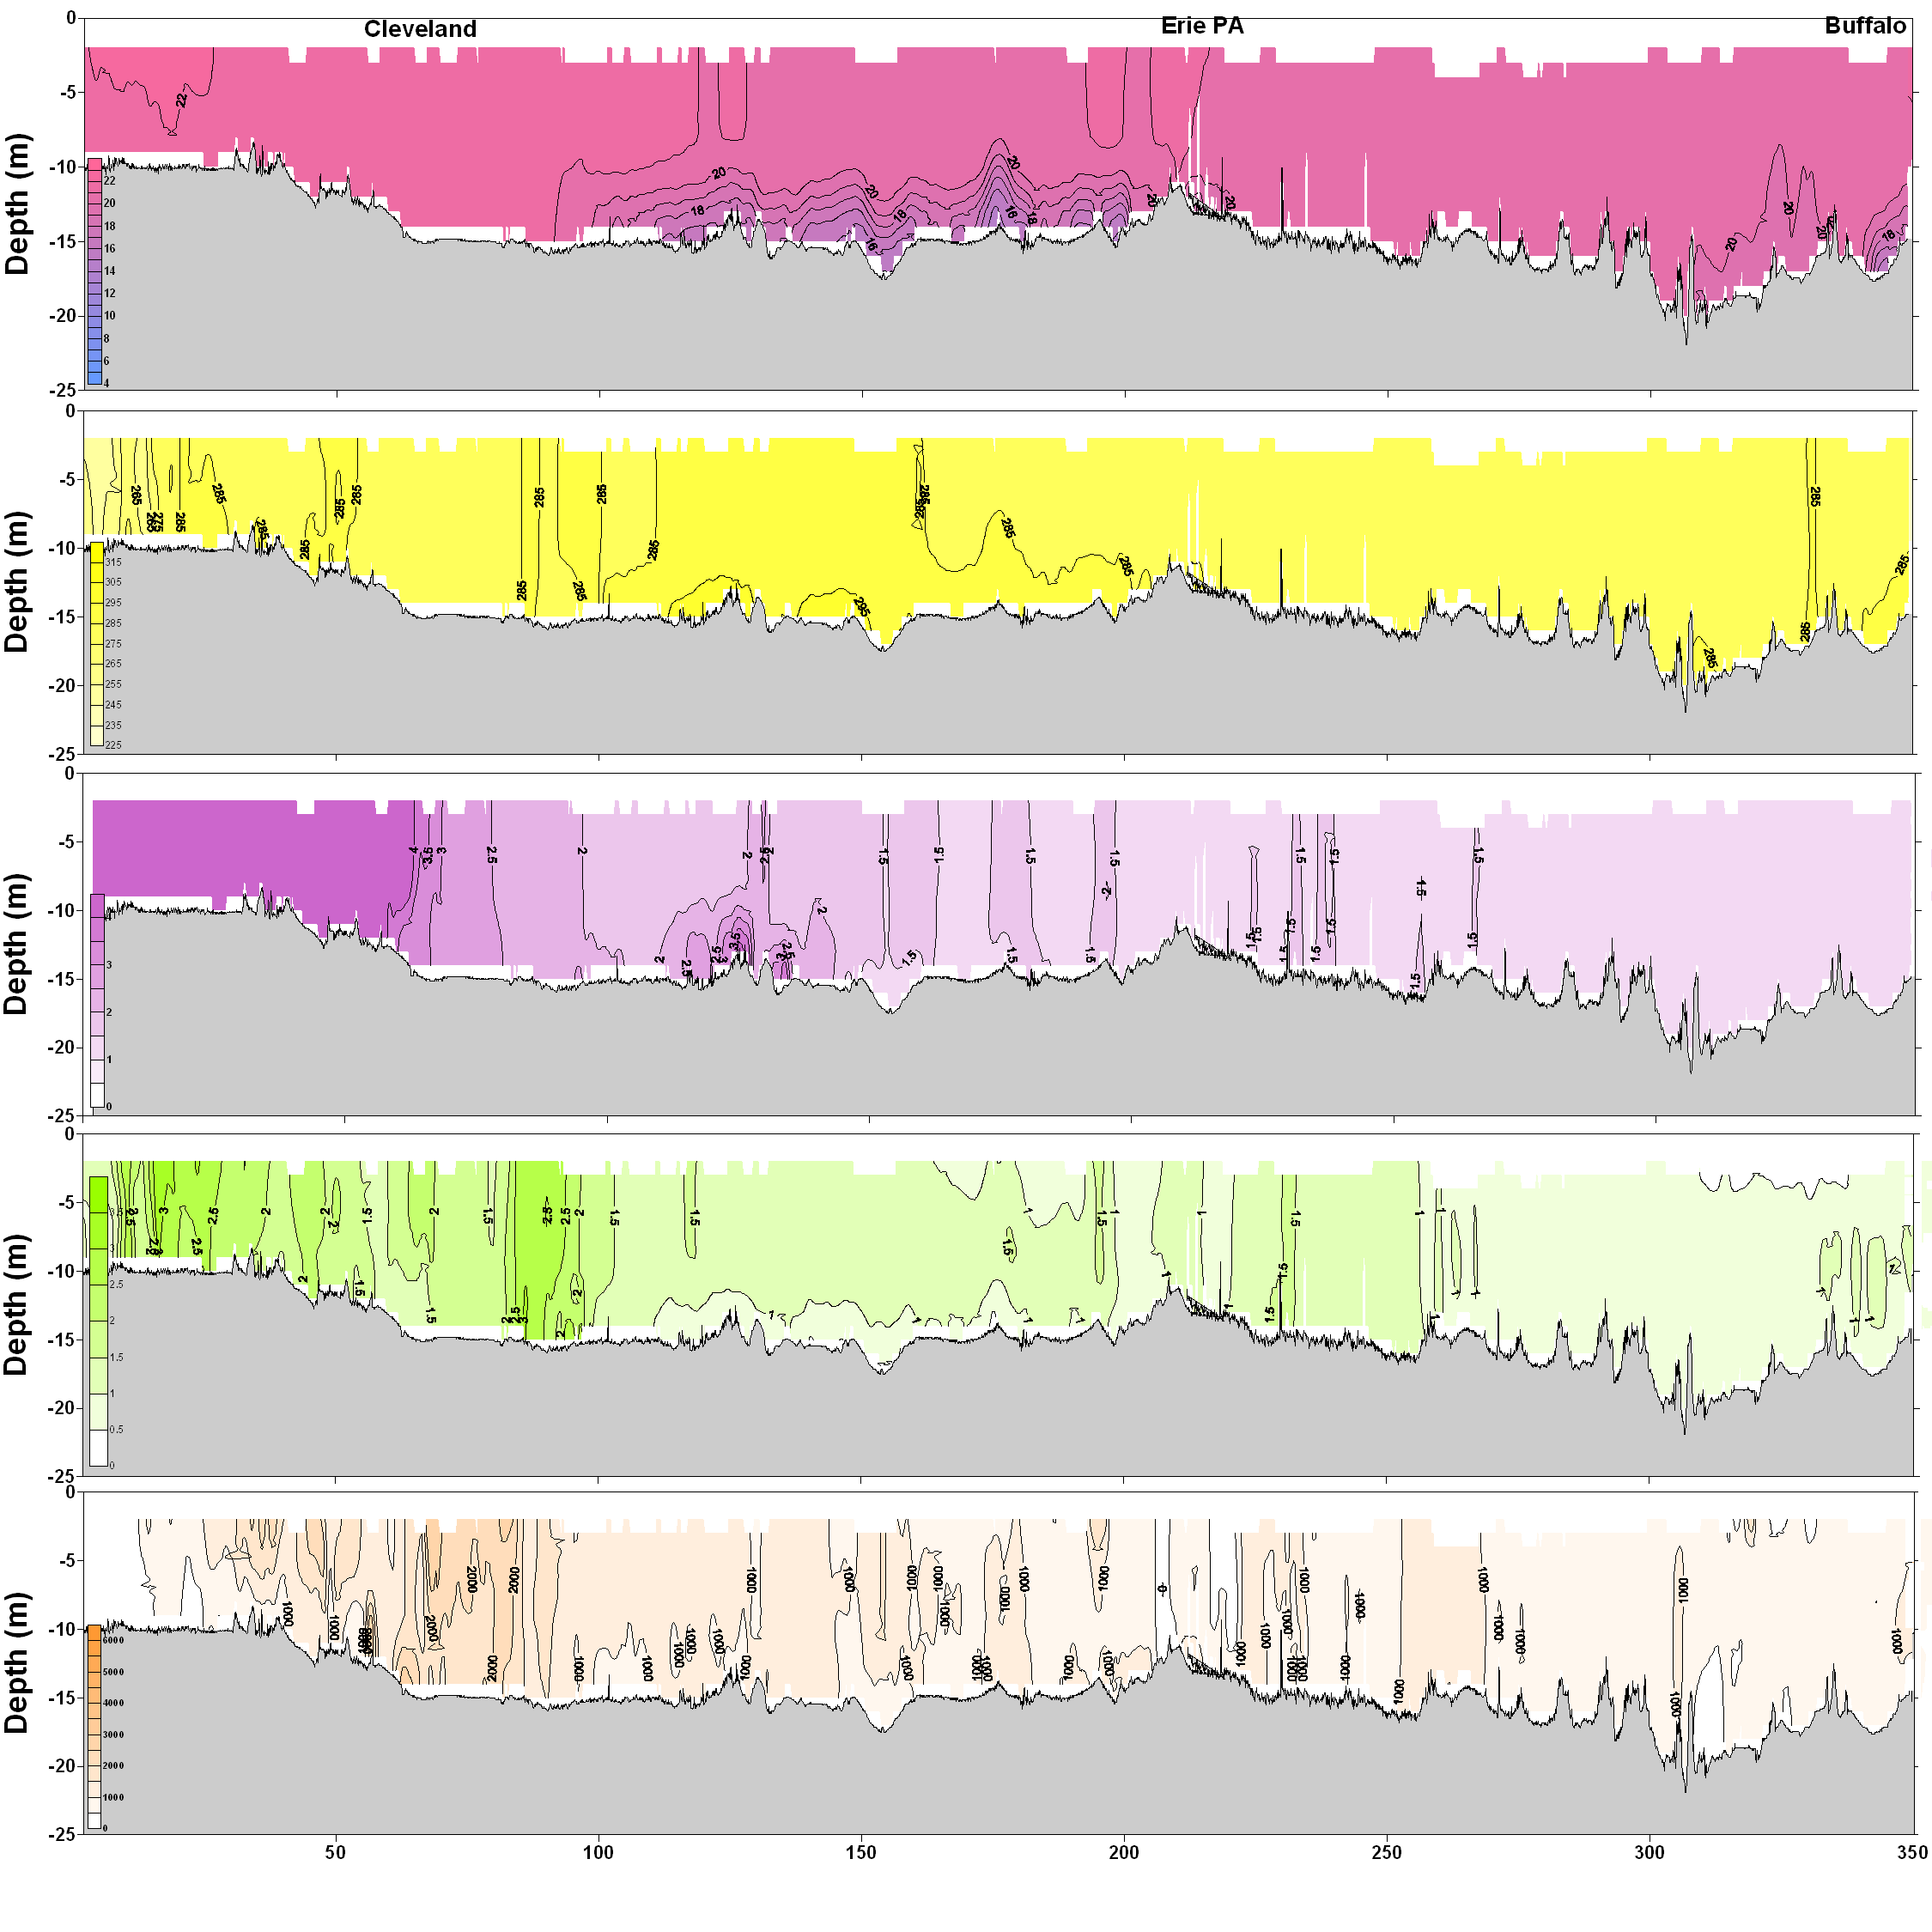
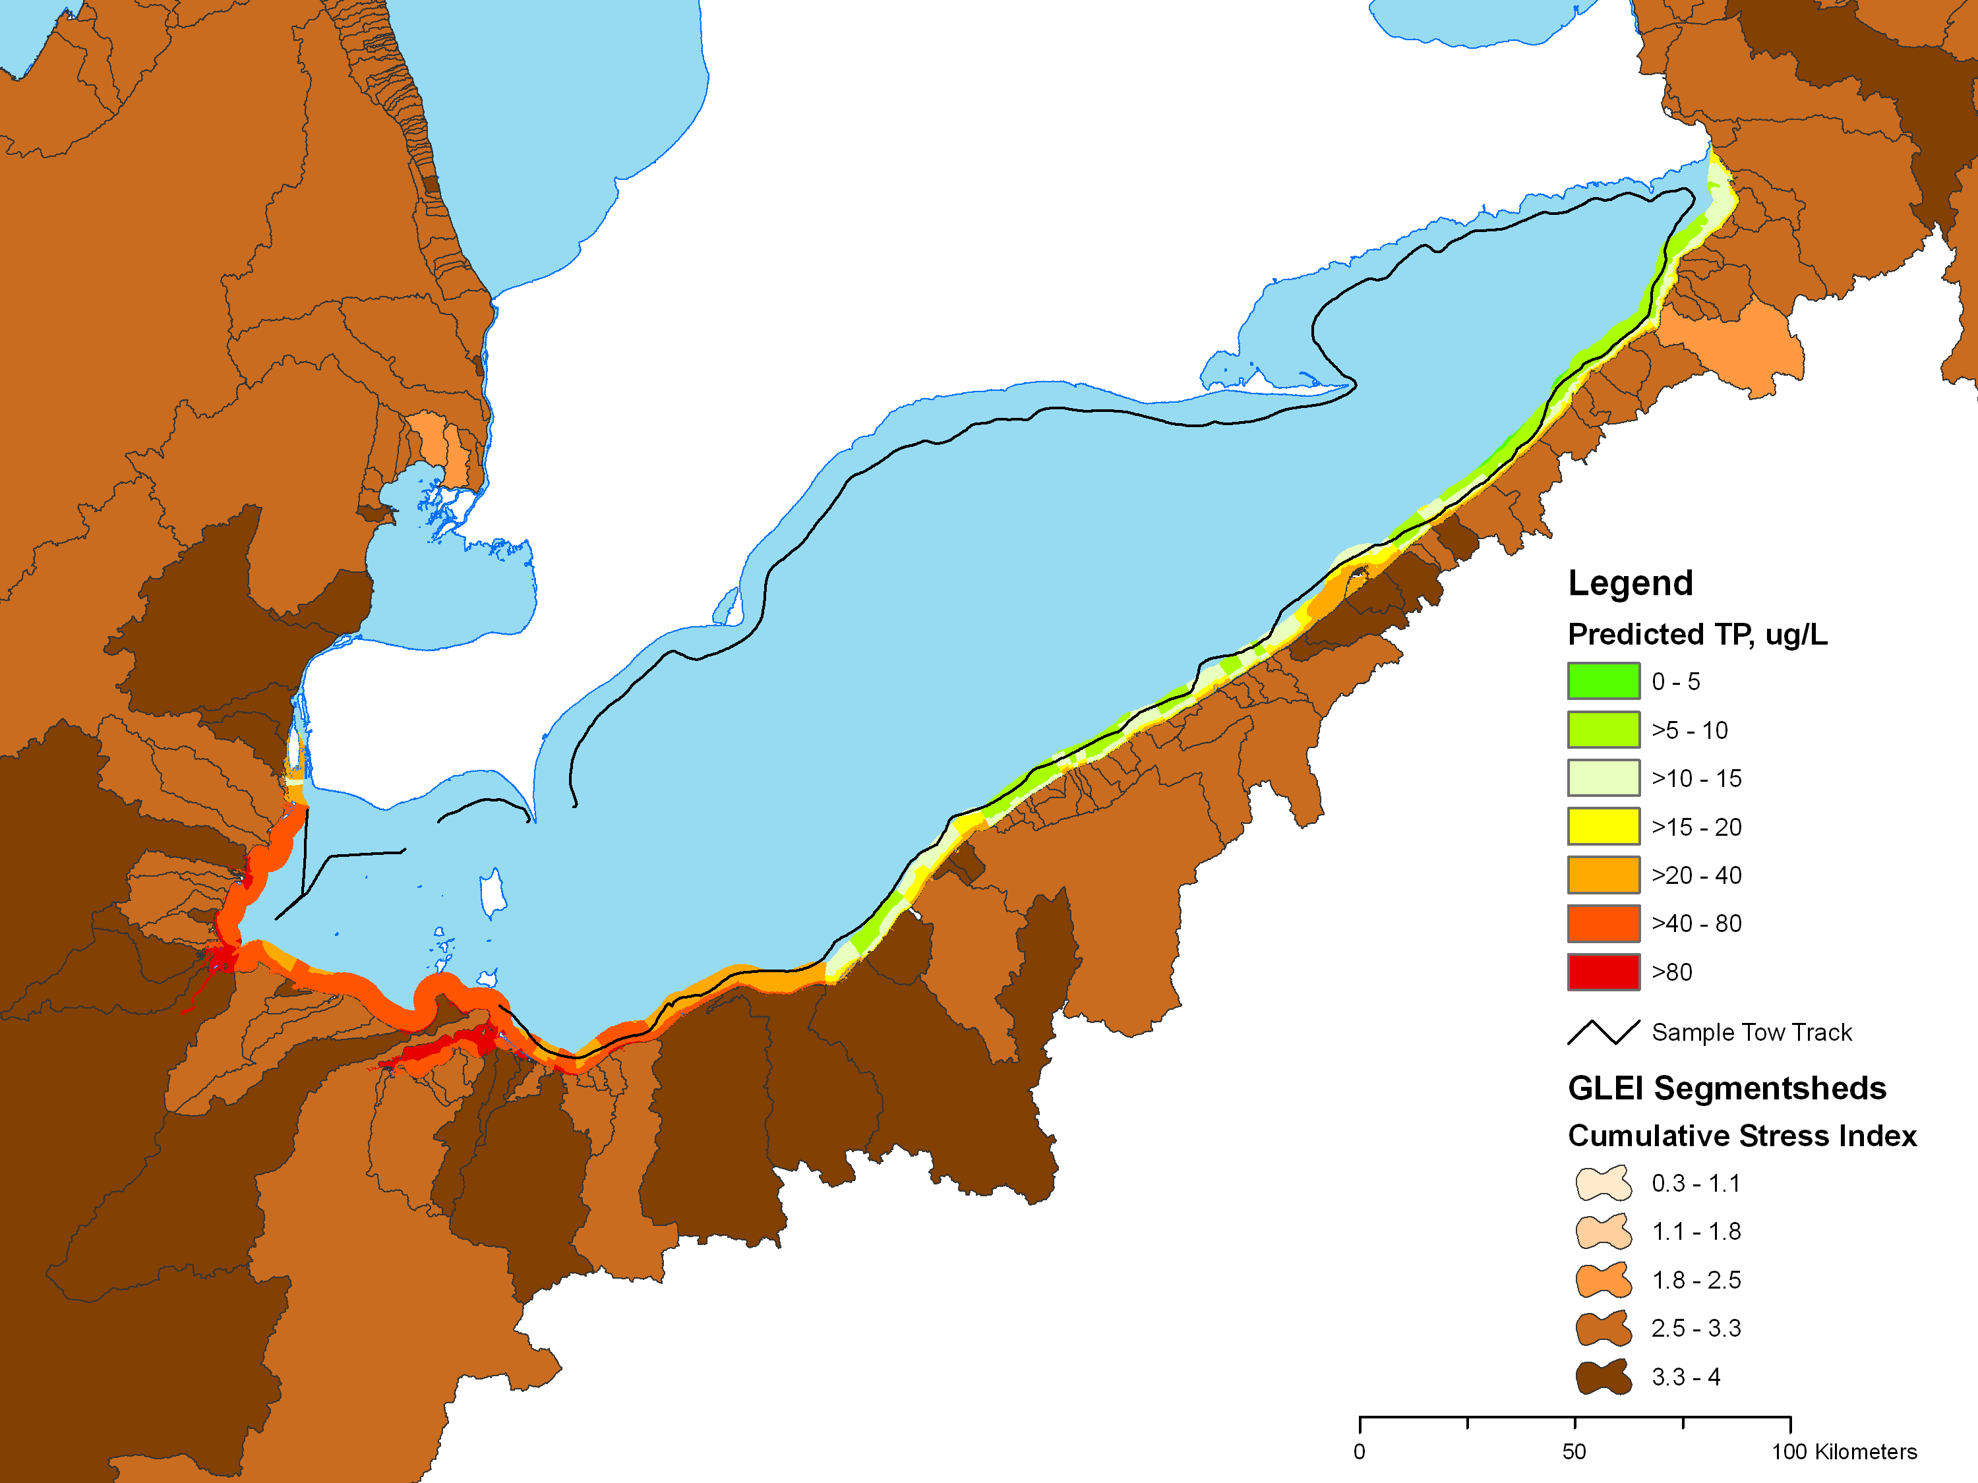
West
East
Temperature
Integrated Nearshore Observing/Model System
Specific Conductivity
Transmissivity
Fluorescence
Zooplankton biomass
Results aligned with Shoreline and Tow track
GLEI landscape
characterization
TP spatial model
from NCCA
survey results

Slide 9

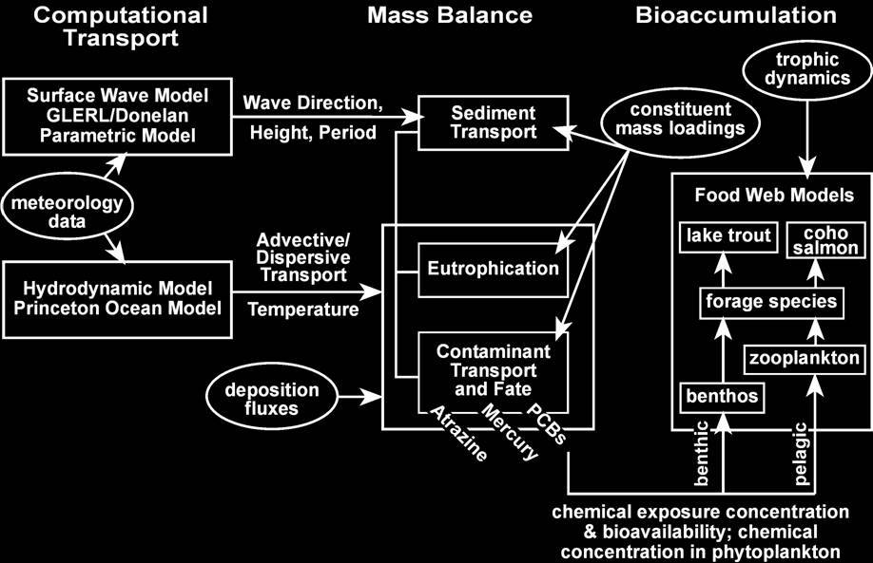
Multimedia Mass Balance Modeling
Notes:
Need to discuss organic carbon based. Add the line back to Eutrophication model

Slide 10
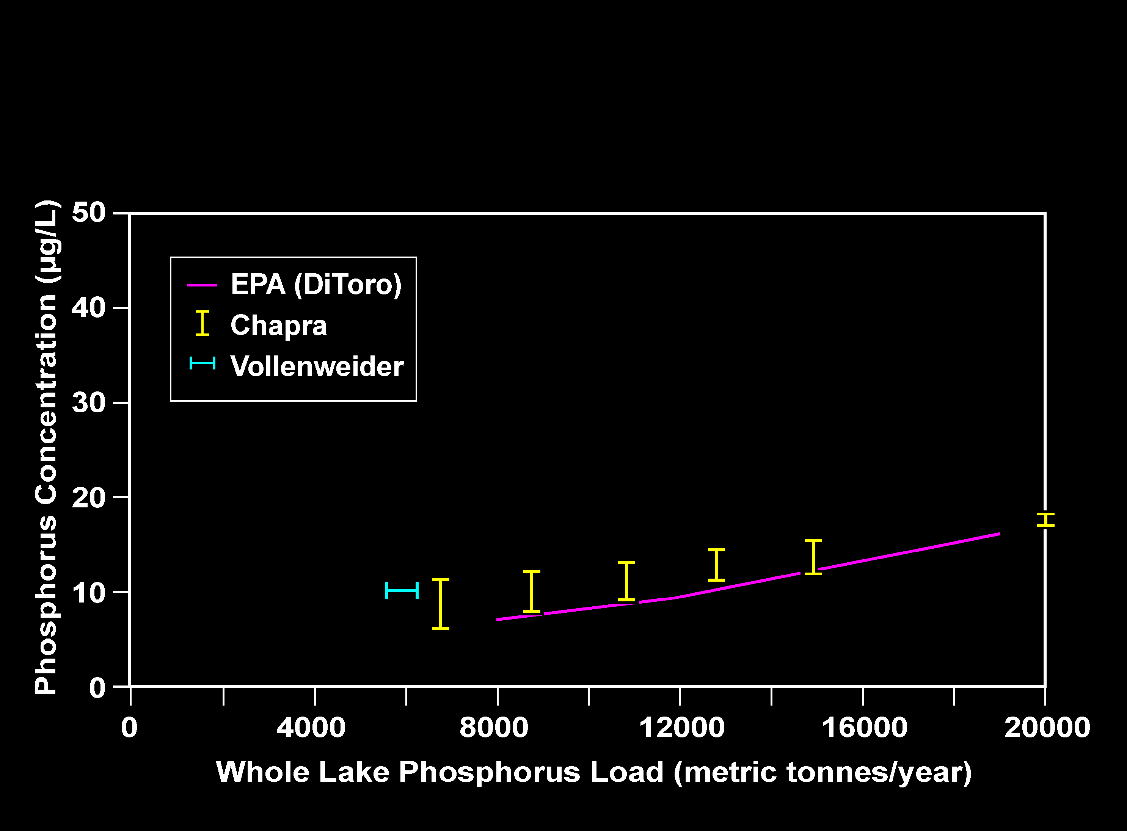
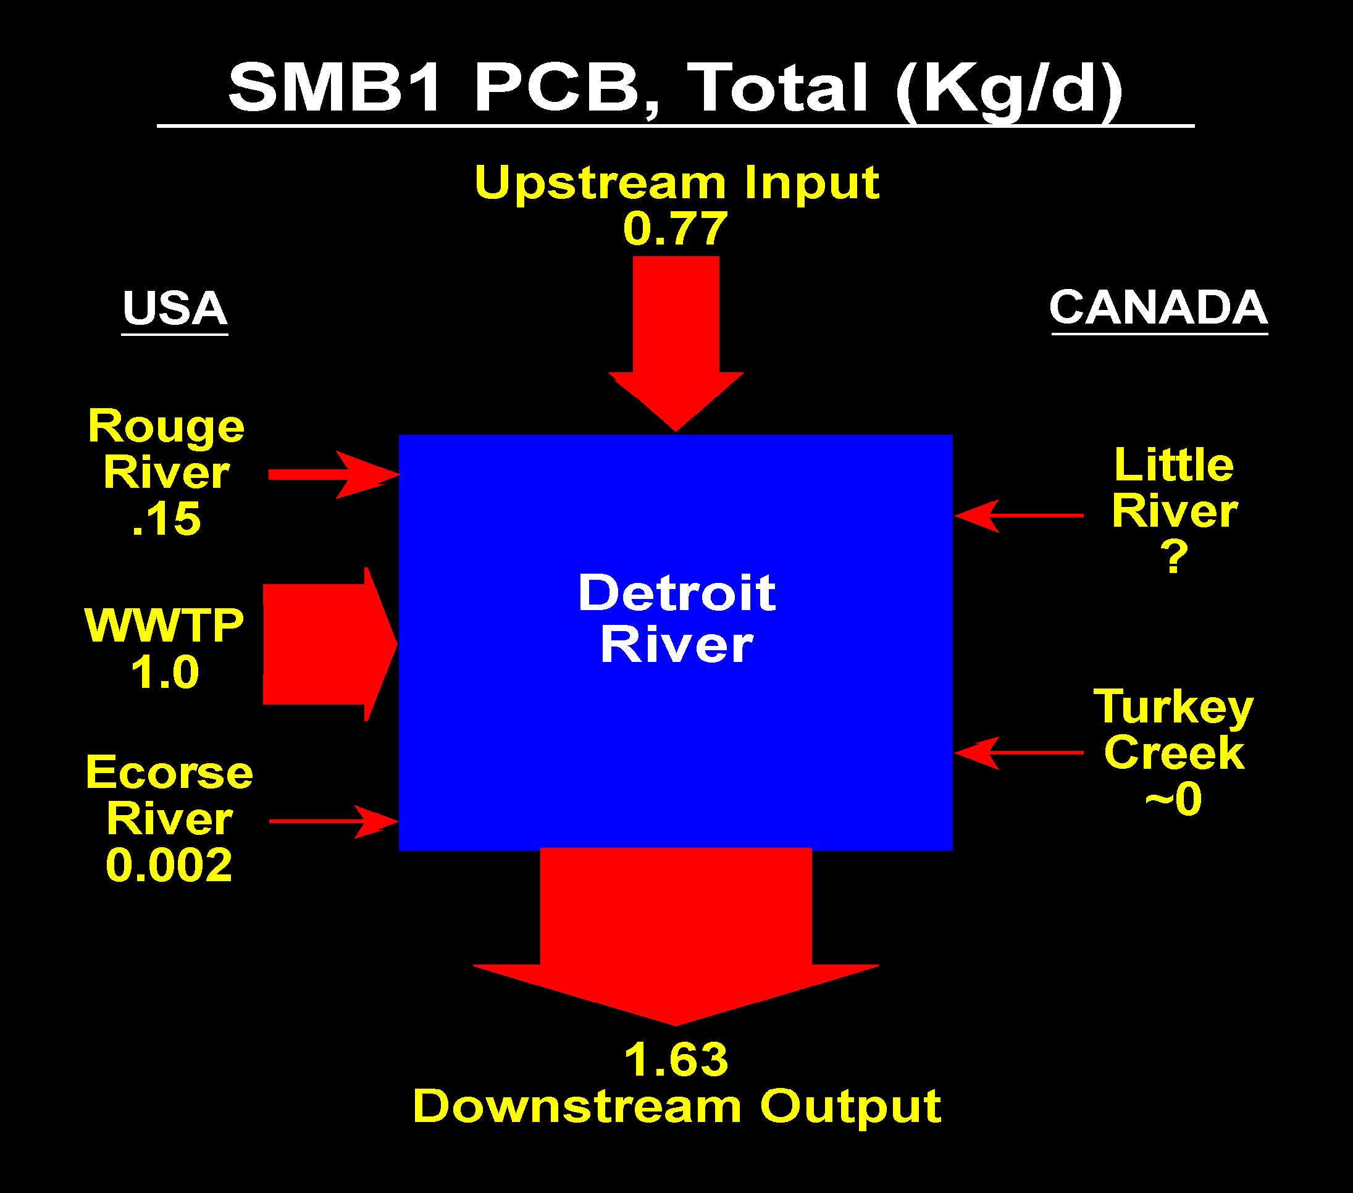
USEPA ORD Modeling in
Lake Erie and the Detroit River
Relationship Between Phosphorus Concentration and
Whole Lake Phosphorus Load in the
Central Basin of Lake Erie for Three Models

Slide 11
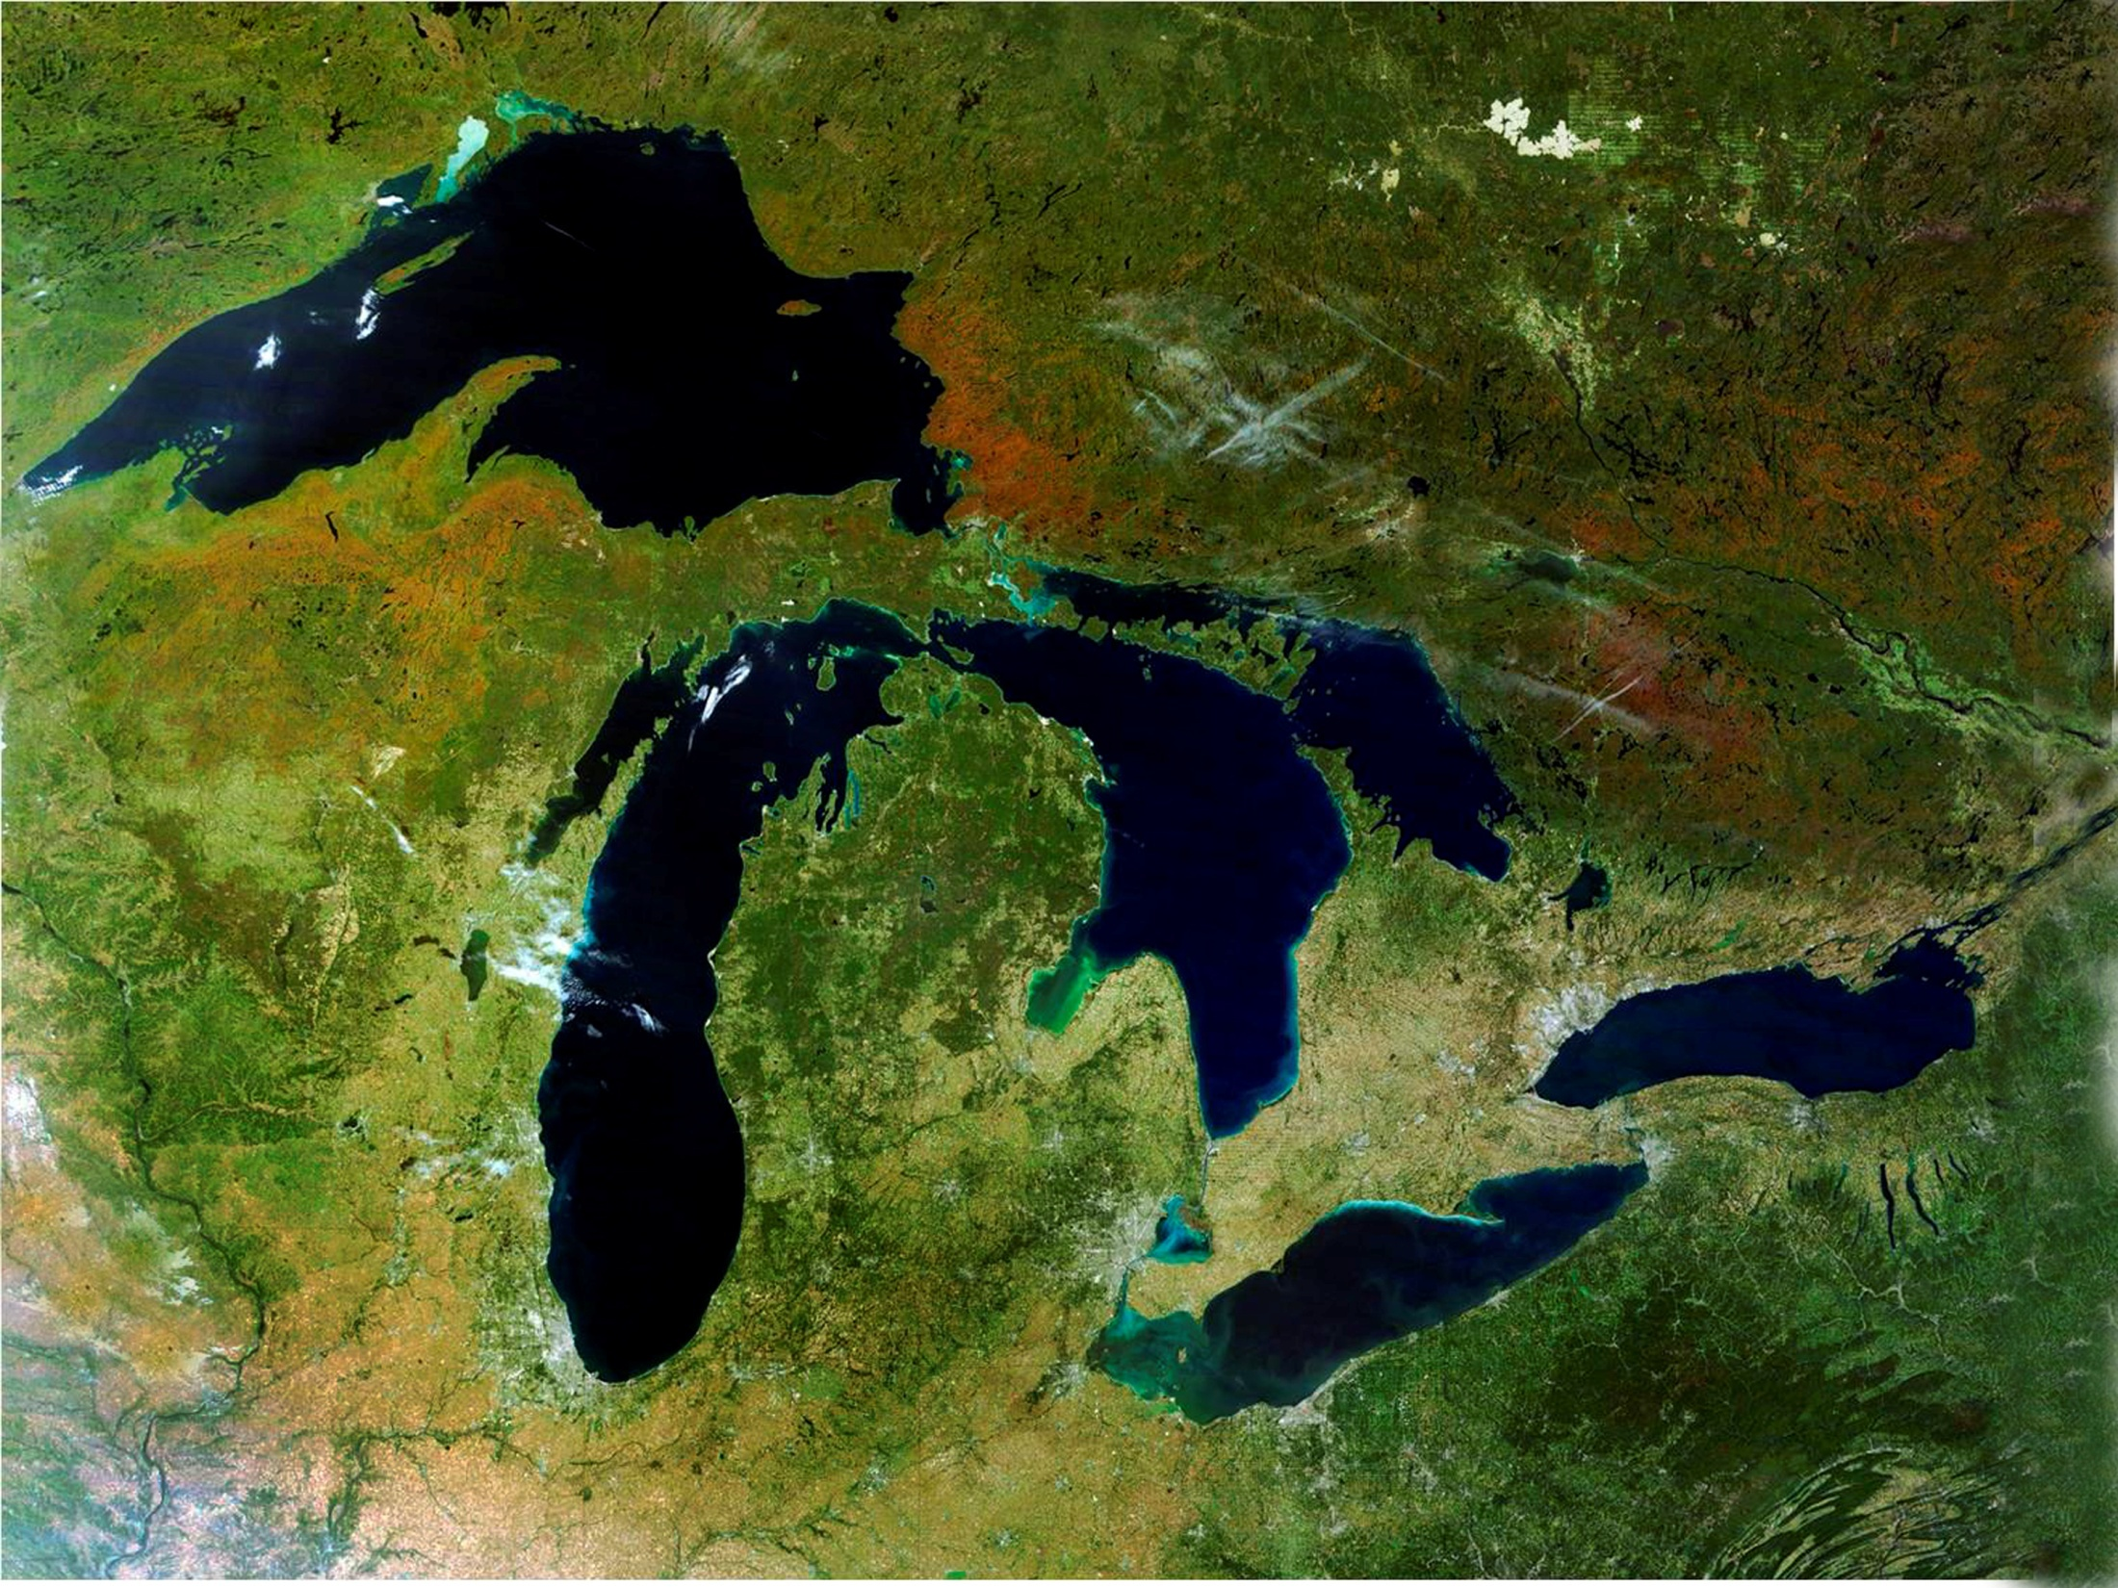

Lake Erie Annual Phosphorus Loads
(Thousands of Metric Tons/Year – MTA)

Slide 12
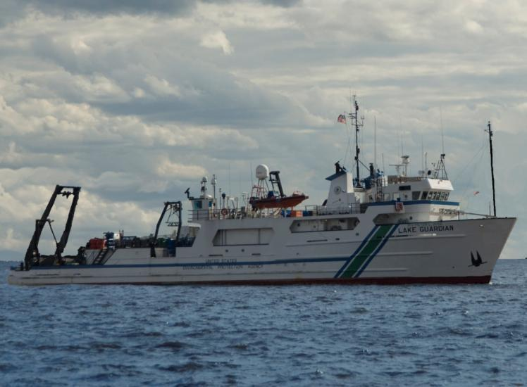
R/V Lake Guardian Specifications
∙ 180 feet long
∙ 11 knot cruising
speed
∙ Bunks for 27
scientists & 13
crew members
∙ 3 laboratories
∙ Sampling gear
Notes:
I’ll start of by providing you with some background information about the ship and then move onto some information about our sampling programs.
The R/V Lake Guardian, operated by the U.S. EPA’s Great Lakes National Program Office (GLNPO), conducts monitoring programs that sample the water, aquatic life, sediments, and air in order to assess the health of the Great Lakes ecosystem during the biannual spring and summer surveys.
The ship itself is 180 feet long by 40 feet wide and is the largest research vessel on the Great Lakes. It travels at a cruising speed of 11 nautical miles per hour and can hold up to 27 scientists along with it’s 13 crew members. The vessel currently has 3 laboratories and holds all necessary sampling gear.
The R/V Lake Guardian has been operating on the waters of the Great Lakes for the past 12 years. The ship is offshore, collecting data, for approximately 7 months a year.
Following this year’s summer survey in August, the ship will enter dry dock where it will undergo major changes. New engines will be installed and laboratory space will be expanded and updated. This new laboratory space will serve multiple purposes, such as functioning as both a classroom or media room when needed. The capability of having live webcasts from the ship will also be available.

Slide 13
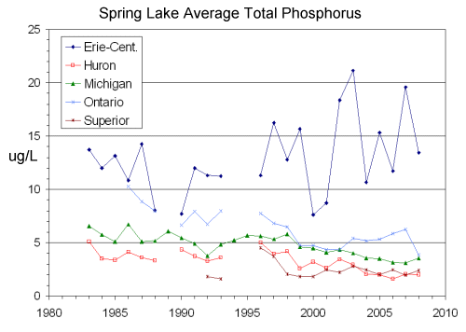
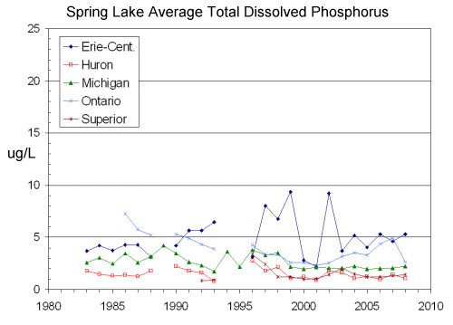
Great Lakes Spring Total and Dissolved Phosphorus Trends, 1983-2008 (USEPA-GLNPO)

Slide 14
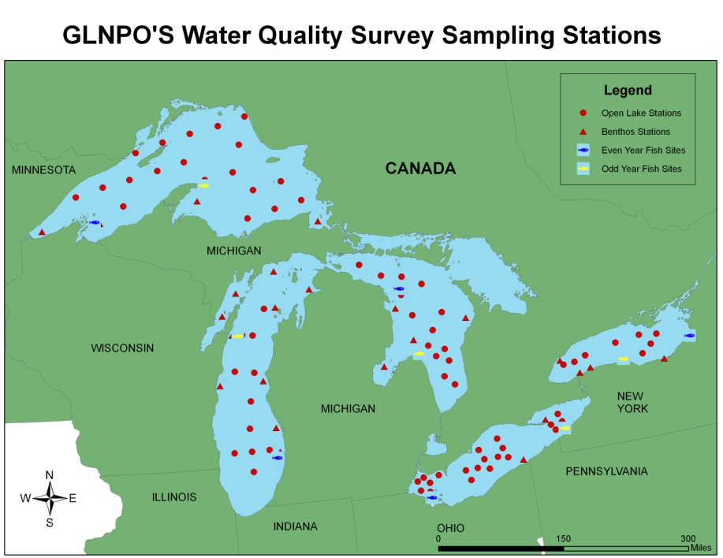
Open Lake Sampling Stations

Slide 15
GLNPO Open Lake Monitoring Program
When?
Annual Monitoring Program - Surveys Biannually
Spring - begins in late March/early April
Summer - begins early August
Approximately 1 Hour per Station
Typical Sequence:
Lakes Michigan, Huron, Erie, Ontario, Superior
Contact: Dr. Glenn Warren
warren.glenn@epa.gov

Slide 16
Water Quality/Biological Metrics
Nutrients
Total, Dissolved, and Soluble Reactive Phosphorus
Nitrite + Nitrate
Soluble Reactive Silica
Particulate C,N,P (Master Stations)
Conventionals
pH, turbidity, alkalinity,
specific conductance
Biological
Phytoplankton, zooplankton and benthos

Slide 17
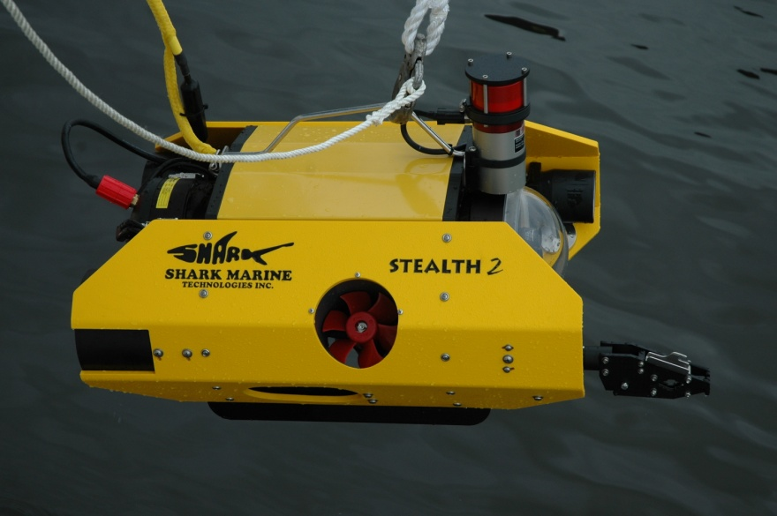
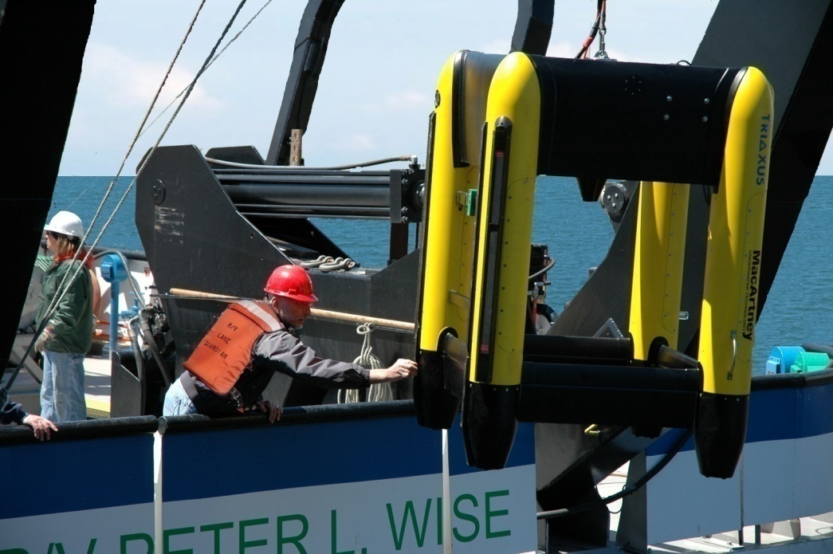
Additional Capabilities and Equipment
Air
Sampling
ROV
Box Corer
Epibenthic Sled
Triaxus
Towed Device

Slide 18
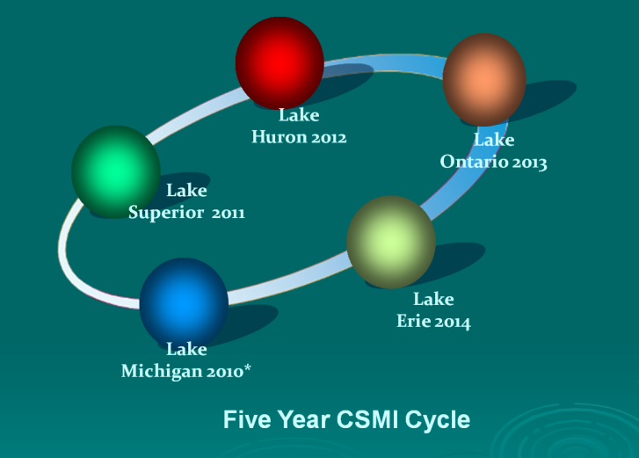
Cooperative Science and
Monitoring Initiative (CSMI)
5-Year Cycle
2013 Lake Ontario
2014 Lake Erie
Sampling approximately monthly for 3-5 days each
Supporting:
Federal, Academic Groups and Education
GLNPO Contractors and Grantees
Great Lakes Restoration Initiative (GLRI) Cooperators
Contact: Dr. Glenn Warren
warren.glenn@epa.gov

Slide 19
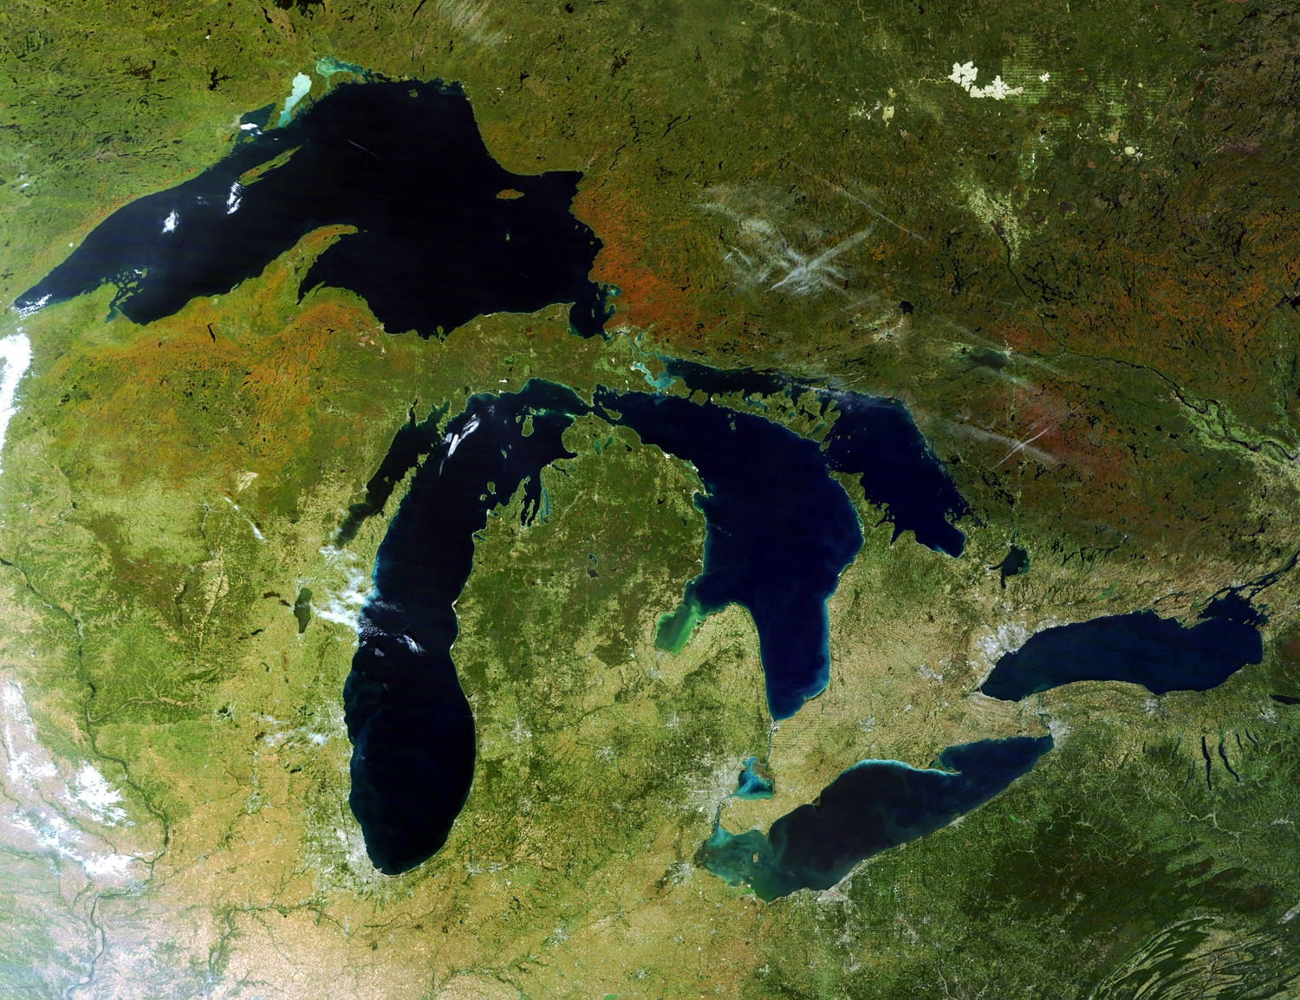
USEPA Opportunities
GLRI Projects
Great Lakes Restoration Initiative
USEPA, GLNPO
http://epa.gov/greatlakes
5
6
9
6
6
4
Basinwide
4
5
Science to Achieve Results (STAR)
ORD-National Center for Environmental Research
http://epa.gov/ncer/rfa

